Slide 1


24-Hour average load
Electric Power Load Analysis (EPLA)
Revision of 10 June 2026
Dr. Norbert Doerry
http://doerry.org/norbert/MarineElectricalPowerSystems/index.htm
© 2026 by Norbert Doerry
This work is licensed via: CC BY 4.0 (https://creativecommons.org/)

Slide 2
Essential Questions
What is the 24-hour average load and what is it used for? | Understand
When is it appropriate to use the 24-hour average load parametric equation? | Understand
How is the 24-hour average load calculated? | Apply

Slide 3
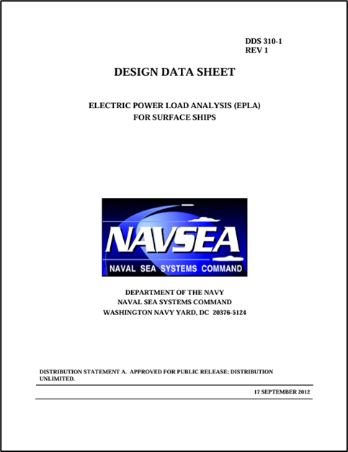
24-hour average load
Used to calculate the average load for generator sets over a 24-hour period for the purpose of calculating fuel consumption rates
Fuel consumption rates used for:
  Endurance fuel calculations (DPC 200-1)
  Annual energy usage calculations (DPC 200-2)
Calculation methods
  Load factor analysis
  Stochastic analysis
  Modeling and simulation analysis
  24-hour average load parametric equation
See details in DPC 310-1

Slide 4
Load modeling considerations
The total load is usually calculated at the total ship level rather than for specific power system equipment.
  If the ship is operated in split plant, then the total load for each independent power system is calculated.
Loads that are correlated (likely to be “on” at the same time, or likely to be “off” at the same time) need not be modeled together
  Determining a load’s long-term average is sufficient.
Accounting for cycling loads being at their peak value is not required
  Zonal load factor analysis is not applicable.
If for a given type of load (fire pumps for example) if only a subset of the loads is on during a given operational condition, then it usually does not matter which loads (of a particular type of load) comprise the subset.

Slide 5
Load factor analysis
Load factors should be based on long term averages
Tables in DPC 310-1 should not be directly used for 24-hour average computations; these tables are for equipment sizing
Tables in IEEE 45.1 may be used if better information not available
Ideally, load factors should be based on measured data
  May require adjustment if the design under analysis differs from the system measured
  May require adjustment if the equipment under analysis is intended to operate differently than the system measured

Slide 6
Stochastic analysis
Mean value of the sum of the loads obtained by Monte Carlo analysis (or equivalent) should be used.
Enough samples should be calculated to reduce error in the mean value estimate to a desirable level.

Slide 7
Modeling and simulation analysis
The average value of the time-based waveform is used
Should use a total simulation time on the order of 2400 hours to ensure a good estimate of the 24-hour average load

Slide 8
24-hour average load parametric equation
Should only be used in early-stage design
In preliminary design and later, use an alternate method
Based on 100° F loads calculated for equipment sizing
Surface ships other than aircraft carriers and large deck amphibious ships:
  P_{24_hour_ave} = P_{prop_steering} +0.75(P_{cruise} – P_{prop_steering})
Aircraft carriers and large deck amphibious ships
  P_{24_hour_ave} = P_{prop_steering} +0.60(P_{cruise} – P_{prop_steering})
Where:
  P_{24_hour_ave} = 24-hour average ship service load
  P_{prop_steering} = Propulsion plant and steering systems loads
  P_{cruise} = Cruising ship operating condition load with margins and service life allowance

